Slide 1


Reducing controversy by connecting opposing views
kiran garimella
Gianmarco De Francisci Morales
Aristides Gionis
Michael Mathioudakis

Slide 2
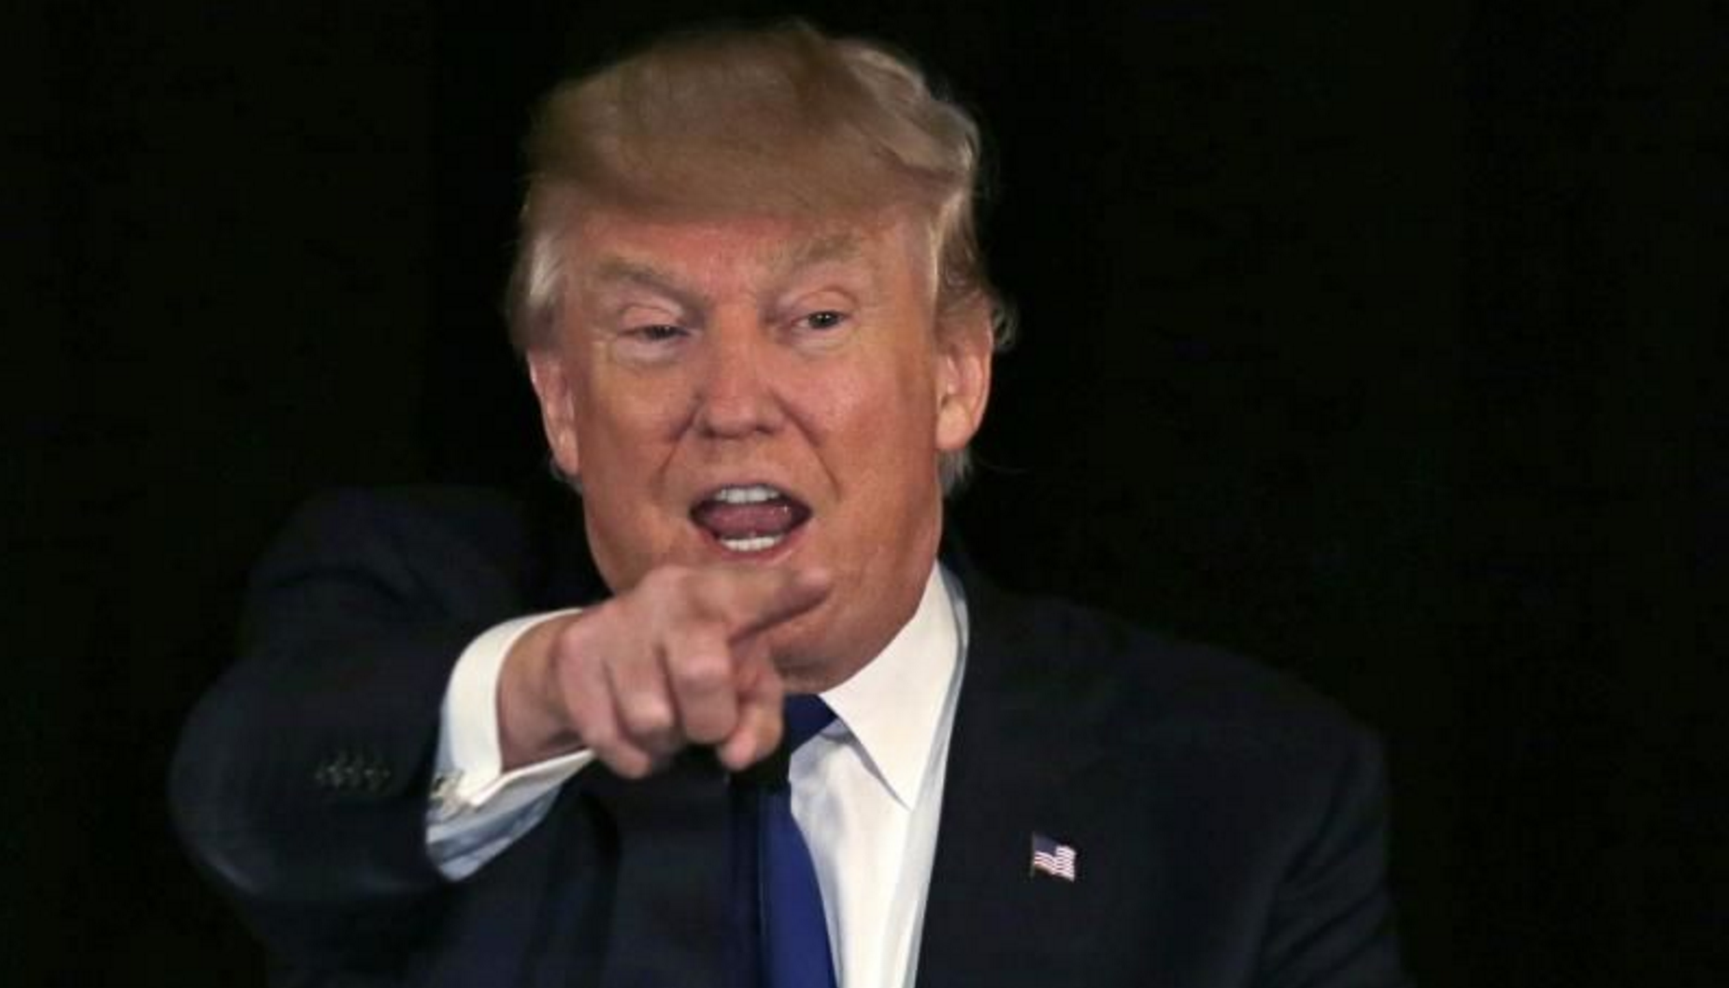
Controversies are everywhere!

Slide 3
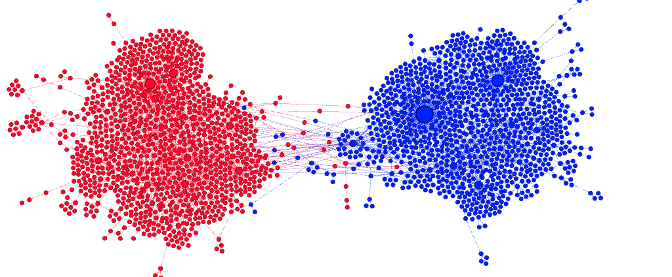
Twitter
Garimella et al. WSDM 2016

Slide 4
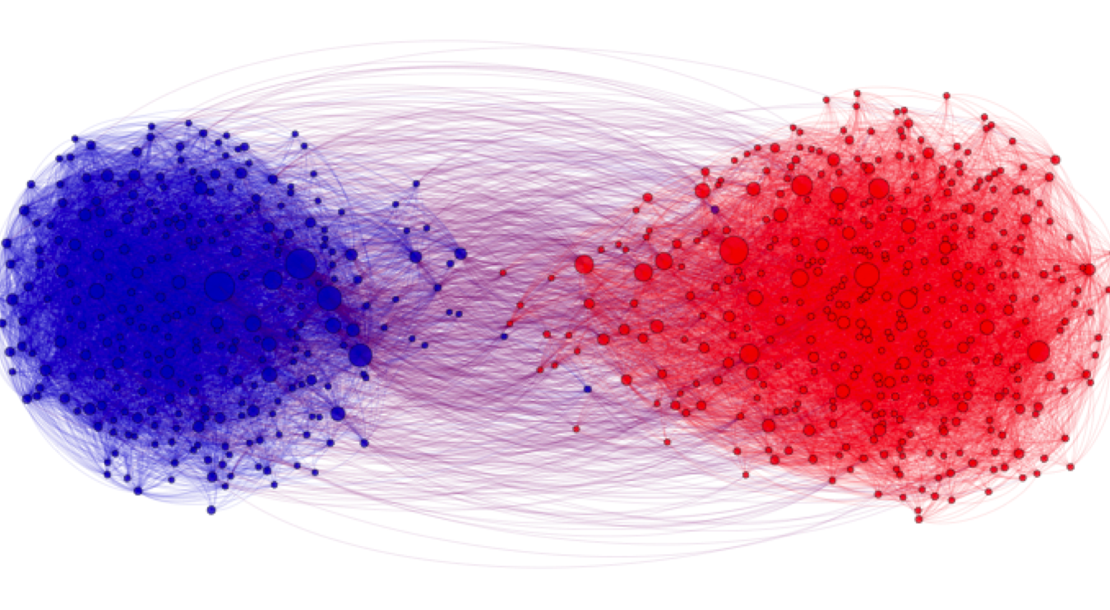
Blogs

Slide 5
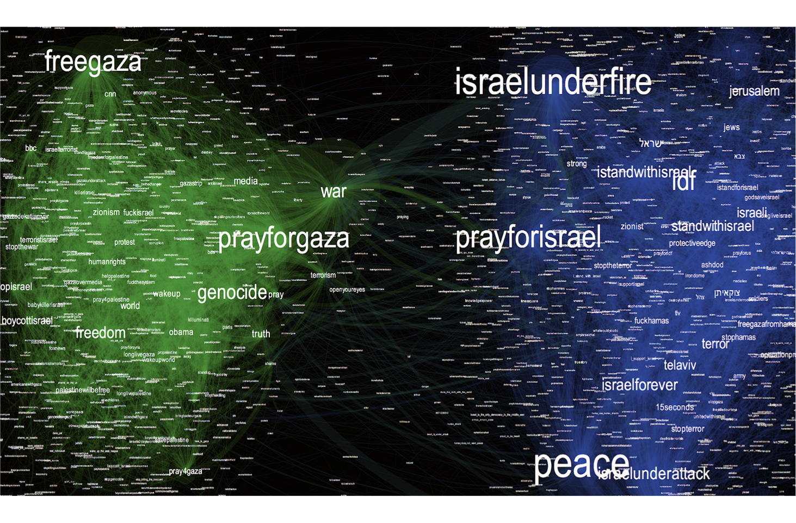
Instagram

Slide 6
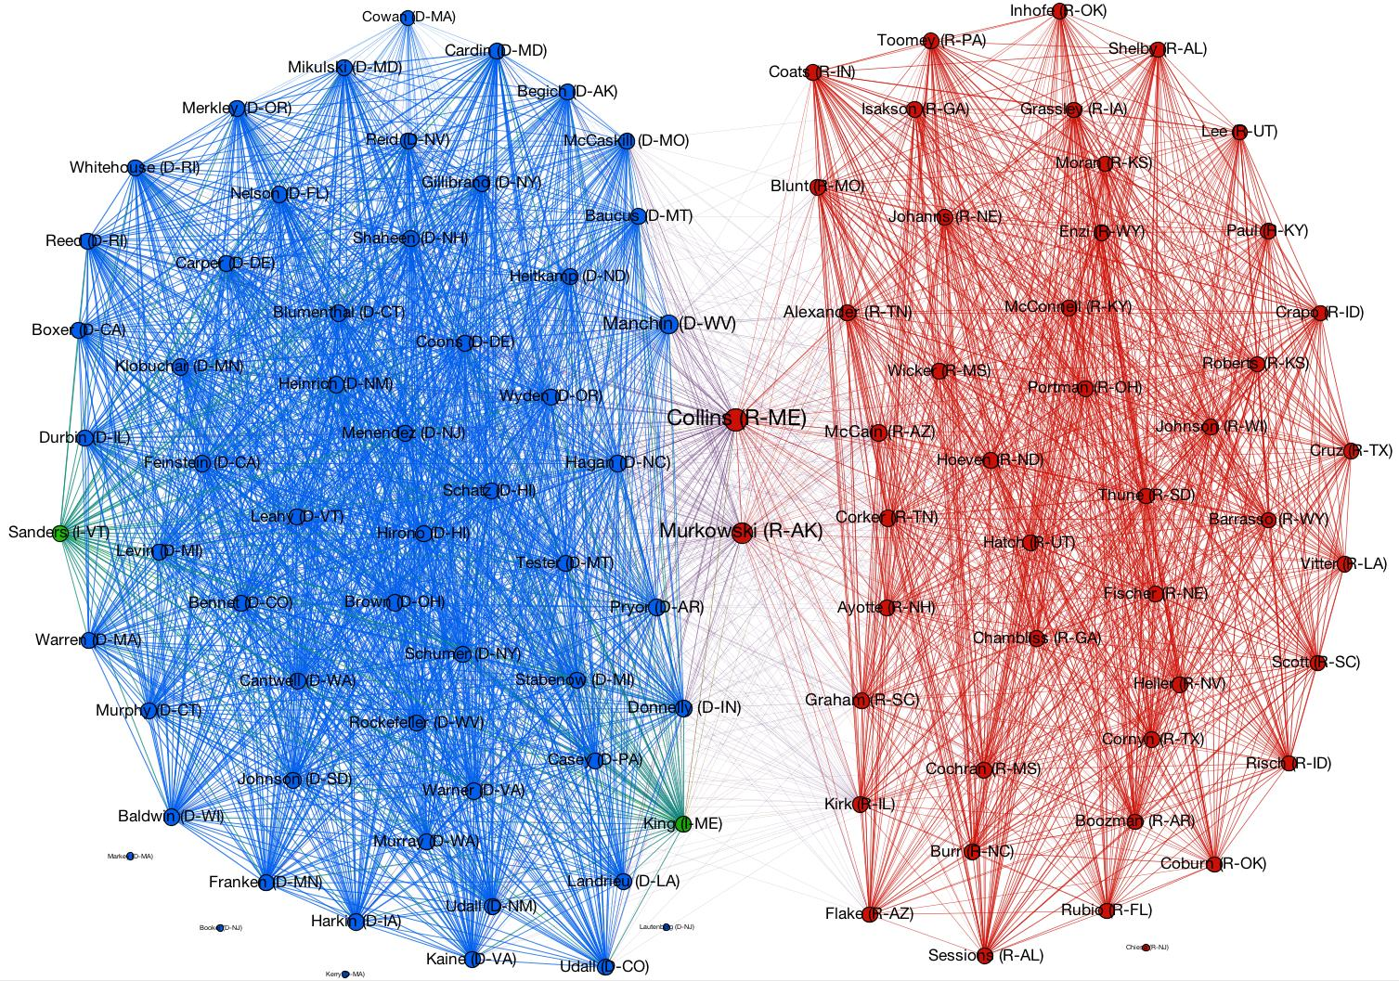
US Senate VOTes

Slide 7
How can we bridge the divide?
This Paper

Slide 8
How Can we bridge the divide?
Reducing controversy by connecting opposing views
Connect the two sides
Twitter
Model interactions as a graph
Retweet graph ➔ Nodes: users, Edges: retweets
Measure of Polarization
How well does information flow between the two sides?
Based on random walks
Notes:
Edges: Recommendations

Slide 9
Problem: Given a graph and two sides, find the k best edges that maximize the reduction in polarization

Slide 10
Reducing controversy by connecting opposing views
Reducing Controversy by Connecting Opposing Views
Side 1
Side 2

Slide 11
Reducing controversy by connecting opposing views
Algorithms
Greedy
Look for all pairs of nodes
Find the k pairs that give the highest reduction in the polarization score
O(n²), n: number of nodes

Slide 12
Reducing controversy by connecting opposing views
Our algorithm
Side 1
Side 2
The best edges are between the highest degree nodes

Slide 13
Reducing controversy by connecting opposing views
Our algorithm
Side 1
Side 2
The best edges are between the highest degree nodes
O(p²), p << n

Slide 14
Reducing controversy by connecting opposing views
But it Might not materialize
High degree users ➔ Highly retweeted users
We can not recommend @realDonaldTrump to retweet @BarackObama
Not practical, not likely to materialize

Slide 15
Acceptance probability
Reducing controversy by connecting opposing views
Take into account the probability of the user accepting the recommendation
Learn probabilities from the data

Slide 16
Visit the posteR…
Details about the polarization score
Acceptance probability model
How we combine polarization minimization and acceptance probability
Experiments and findings

